Slide 1
Generative Adversarial Network (GAN)
Notes:
http://www.inference.vc/my-summary-of-adversarial-training-nips-workshop/
I should follow this https://epsilon-lee.github.io/blog/GANs-Basics.html
F-GAN
W-GAN x 2
LS-GAN
Loss sentisive
EB-GAN

Slide 2
Slide credits
Most of these slides were adapted from:
Hung-yi Lee (National Taiwan University)
Kris Kitani (Carnegie Mellon University).
Noah Snavely (Cornell University).
Fei-Fei Li (Stanford University).

Slide 3
NIPS 2016 Tutorial: Generative Adversarial Networks
Author: Ian Goodfellow
Paper: https://arxiv.org/abs/1701.00160
Video: https://channel9.msdn.com/Events/Neural-Information-Processing-Systems-Conference/Neural-Information-Processing-Systems-Conference-NIPS-2016/Generative-Adversarial-Networks
You can find tips for training GAN here:
https://github.com/soumith/ganhacks
Notes:
https://github.com/zhangqianhui/AdversarialNetsPapers

Slide 4
Review

Slide 5
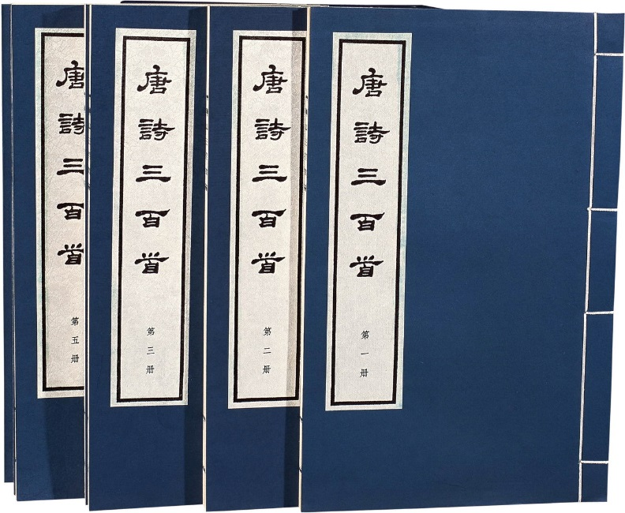












Generation
http://www.rb139.com/index.php?s=/Lot/44547
Writing Poems?
Drawing?
Notes:
就像教小朋友畫圖

Slide 6

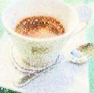
Review: Auto-encoder
As close as possible
NN
Encoder
NN
Decoder
code
Randomly generate a vector as code
NN
Decoder
code
Image ?

Slide 7
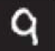
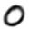
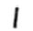
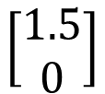
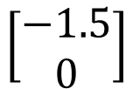
Review: Auto-encoder
2D
NN
Decoder
code
NN
Decoder
$$\left[\begin{aligned}1.5 \\ 0\end{aligned}\right]$$
-1.5
1.5
$$\left[\begin{aligned}−1.5 \\ 0\end{aligned}\right]$$
NN
Decoder
Notes:
SOM: http://alaric-research.blogspot.tw/2011/02/self-organizing-map.html

Slide 8
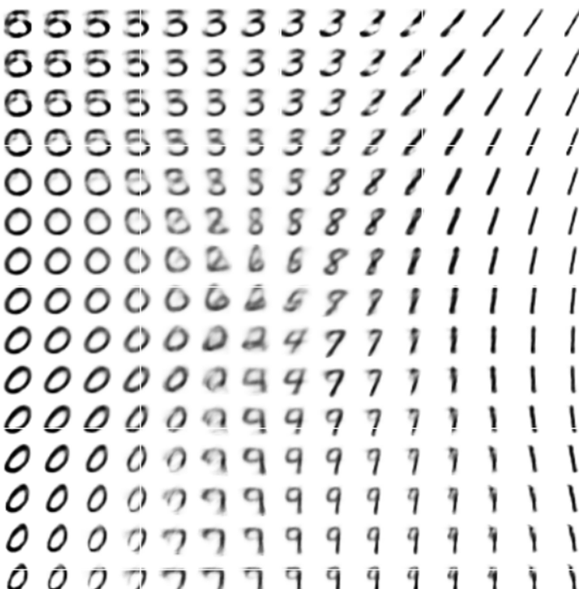
Review: Auto-encoder
-1.5
1.5
Notes:
SOM: http://alaric-research.blogspot.tw/2011/02/self-organizing-map.html

Slide 9
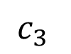
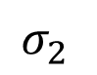
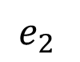
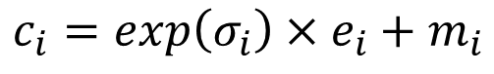
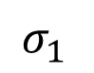
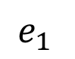
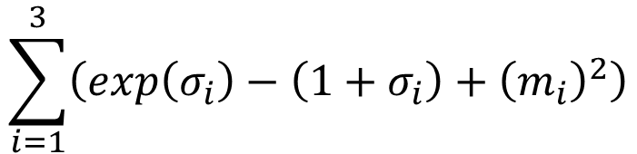
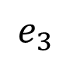
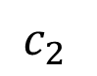
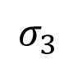
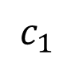
Auto-encoder
NN
Encoder
NN
Decoder
input
output
code
VAE
Minimize reconstruction error
m₁
m₂
NN
Encoder
m₃
$$c_{1}$$
input
NN
Decoder
$$σ_{1}$$
exp
+
$$c_{2}$$
output
$$σ_{2}$$
$$c_{3}$$
$$σ_{3}$$
X
$$c_{i}=exp\left(σ_{i}\right)×e_{i}+m_{i}$$
$$e_{1}$$
From a normal distribution
$$e_{2}$$
Minimize
$$e_{3}$$
$$\sum_{i=1}^{3}{\left(exp\left(σ_{i}\right)−\left(1+σ_{i}\right)+{\left(m_{i}\right)}^{2}\right)}$$
Auto-Encoding Variational Bayes, https://arxiv.org/abs/1312.6114

Slide 10
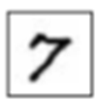
Problems of VAE
It does not really try to simulate real images
code
NN
Decoder
Output
As close as possible
One pixel difference from the target
One pixel difference from the target
Realistic
Fake

Slide 11
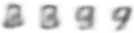
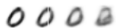
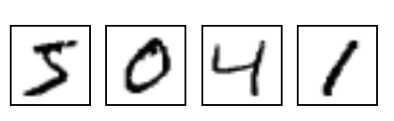
The evolution of generation
NN
Generator
v1
NN
Generator
v2
NN
Generator
v3
Discri-minator
v1
Discri-minator
v2
Discri-minator
v3
Binary
Classifier
Real images:

Slide 12
The evolution of generation
NN
Generator
v1
NN
Generator
v2
NN
Generator
v3
Discri-minator
v1
Discri-minator
v2
Discri-minator
v3
Real images:
Notes:
Binary
Classifier

Slide 13
GAN - Discriminator
NN
Generator
v1
Randomly sample a vector
0
0
0
0
Something like Decoder in VAE
Real images:
1
1
1
1
image
Discri-minator
v1
(real or fake)
1/0

Slide 14
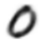
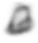
GAN - Generator
Randomly sample a vector
NN
Generator
v1
Updating the parameters of generator
v2
The output be classified as “real” (as close to 1 as possible)
Generator + Discriminator = a network
Discri-minator
v1
Using gradient descent to update the parameters in the generator, but fix the discriminator
1.0
0.13

Slide 15
GAN – Image Generation
Source of images: https://zhuanlan.zhihu.com/p/24767059
DCGAN: https://github.com/carpedm20/DCGAN-tensorflow

Slide 16
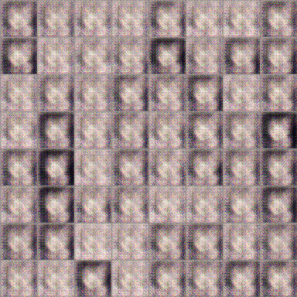
GAN – Image Generation
100 rounds

Slide 17
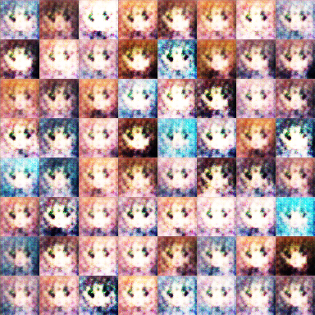
GAN – Image Generation
1000 rounds

Slide 18
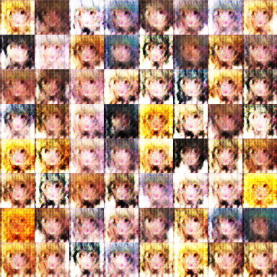
GAN – Image Generation
2000 rounds

Slide 19
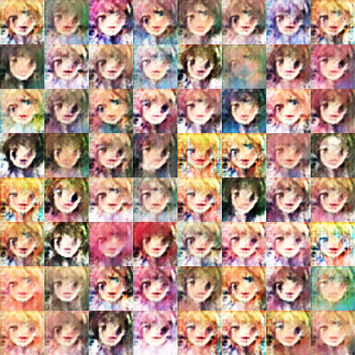
GAN – Image Generation
5000 rounds

Slide 20
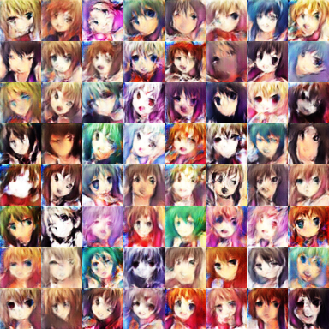
GAN – Image Generation
10,000 rounds

Slide 21
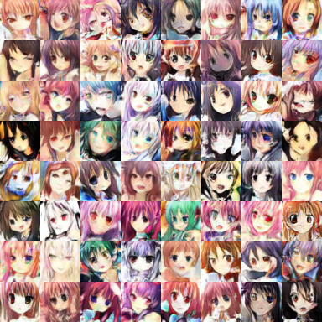
GAN – Image Generation
20,000 rounds

Slide 22
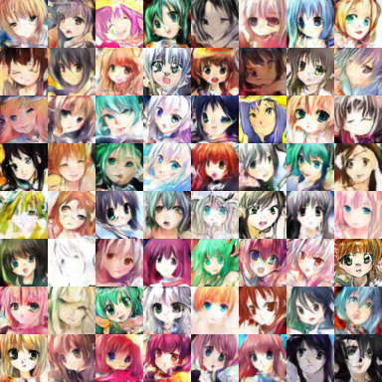
GAN – Image Generation
50,000 rounds

Slide 23
Basic Idea of GAN

Slide 24
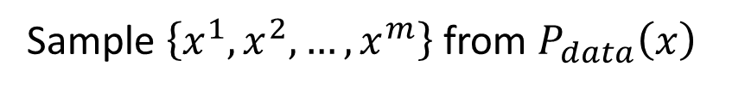
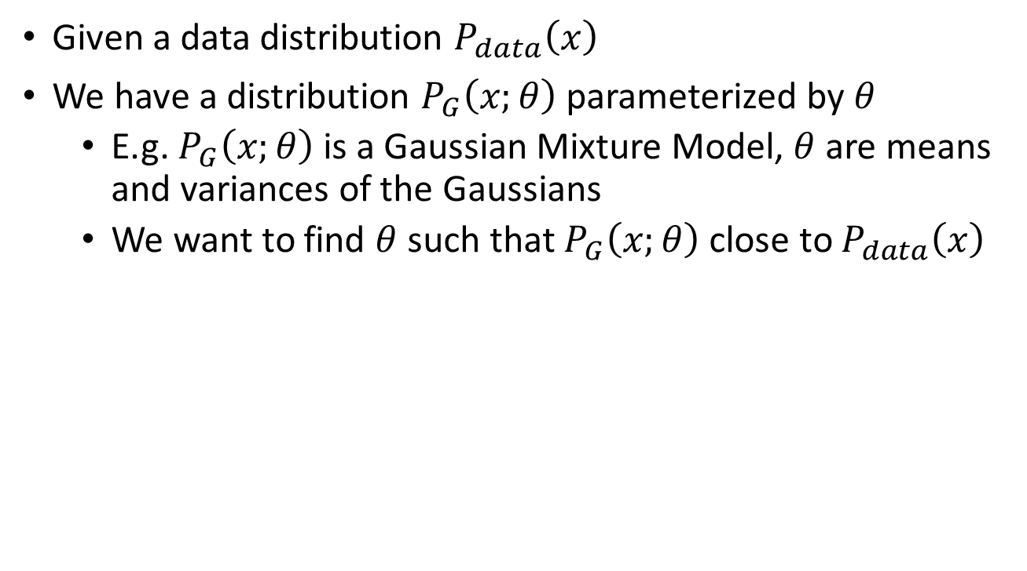
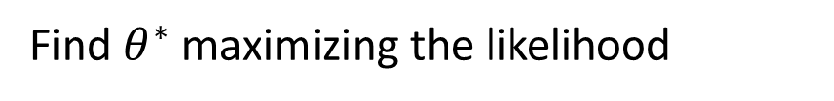
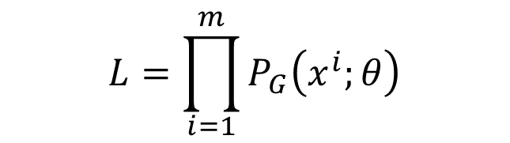
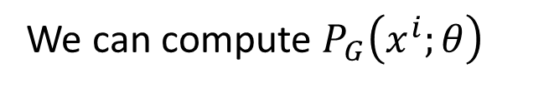
Maximum Likelihood Estimation
Given a data distribution $P_{data}\left(x\right)$
We have a distribution $P_{G}\left(x;θ\right)$ parameterized by $θ$
E.g. $P_{G}\left(x;θ\right)$ is a Gaussian Mixture Model, $θ$ are means and variances of the Gaussians
We want to find $θ$ such that $P_{G}\left(x;θ\right)$ close to $P_{data}\left(x\right)$
Sample $\left\{x^{1},x^{2},…,x^{m}\right\}$ from $P_{data}\left(x\right)$
We can compute $P_{G}\left(x^{i};θ\right)$
Likelihood of generating the samples
$$L=\prod_{i=1}^{m}{P_{G}\left(x^{i};θ\right)}$$
Find $θ^{∗}$ maximizing the likelihood

Slide 25
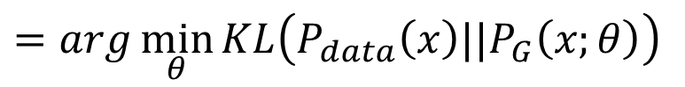
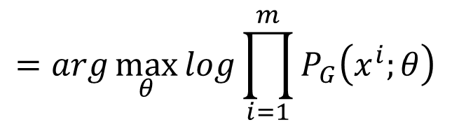
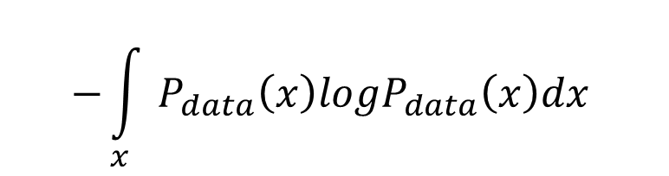
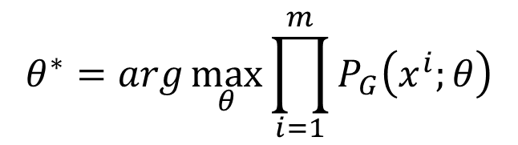
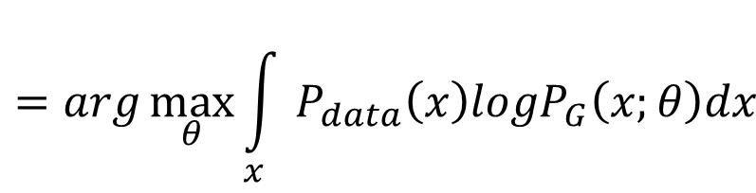
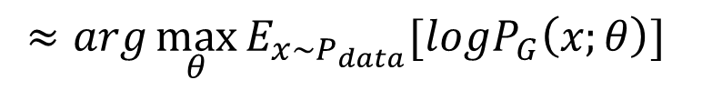
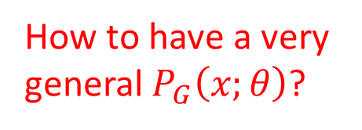
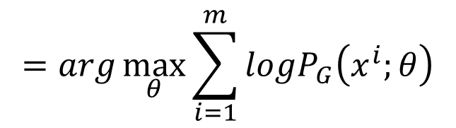
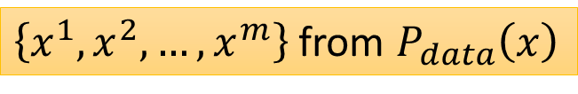
Maximum Likelihood Estimation
$$θ^{∗}=arg\max_{θ}{\prod_{i=1}^{m}{P_{G}\left(x^{i};θ\right)}}$$
$$=arg\max_{θ}{log\prod_{i=1}^{m}{P_{G}\left(x^{i};θ\right)}}$$
$$=arg\max_{θ}{\sum_{i=1}^{m}{logP_{G}\left(x^{i};θ\right)}}$$
$\left\{x^{1},x^{2},…,x^{m}\right\}$ from $P_{data}\left(x\right)$
$$≈arg\max_{θ}{E_{x\sim P_{data}}[logP_{G}\left(x;θ\right)] }$$
$$=arg\max_{θ}{\int_{x}{P_{data}\left(x\right)logP_{G}\left(x;θ\right)dx} }$$
$$−{\int_{x}{P_{data}\left(x\right)logP_{data}\left(x\right)dx} }$$
How to have a very general $P_{G}\left(x;θ\right)$?
$$=arg\min_{θ}{KL\left(P_{data}\left(x\right)||P_{G}\left(x;θ\right)\right) }$$

Slide 26
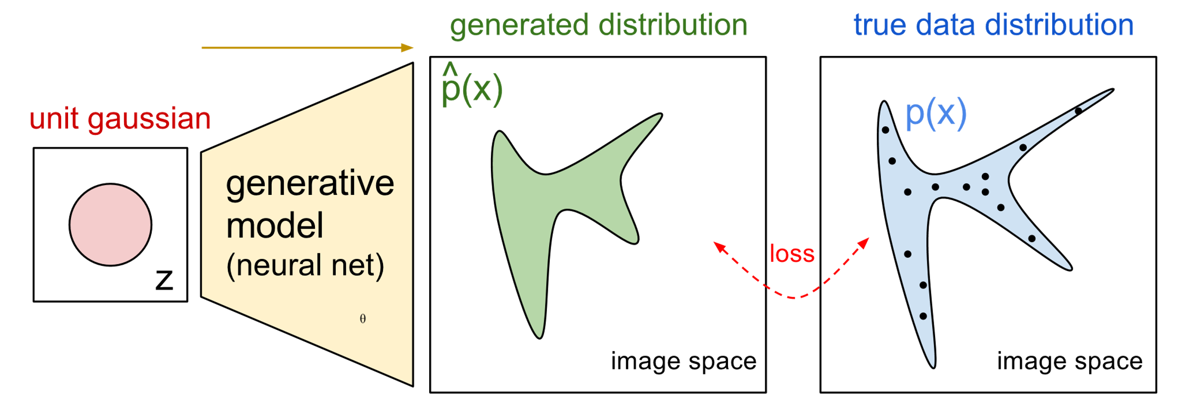



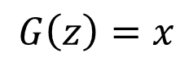
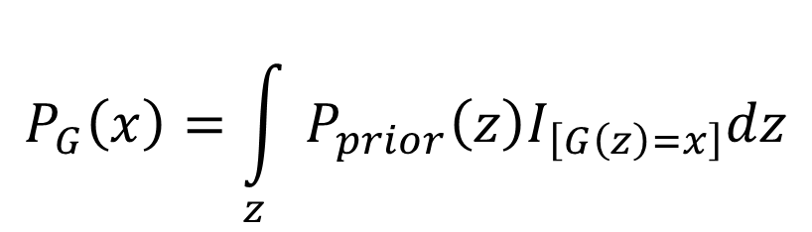
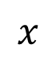
Now $P_{G}\left(x;θ\right)$ is a NN
$$P_{G}\left(x;θ\right)$$
$$P_{data}\left(x\right)$$
$$G\left(z\right)=x$$
$$x$$
$$P_{G}\left(x\right)=\int_{z}{P_{prior}\left(z\right)I_{\left[G\left(z\right)=x\right]}dz}$$
It is difficult to compute the likelihood.
https://blog.openai.com/generative-models/

Slide 27

Basic Idea of GAN
Generator G
G is a function, input z, output x
Given a prior distribution P_{prior}(z), a probability distribution P_{G}(x) is defined by function G
Discriminator D
D is a function, input x, output scalar
Evaluate the “difference” between P_{G}(x) and P_{data}(x)
There is a function V(G,D).
Hard to learn by maximum likelihood
$$G^{∗}=arg\min_{G}{\max_{D}{V\left(G,D\right)}}$$

Slide 28











Basic Idea
$$G^{∗}=arg\min_{G}{\max_{D}{V\left(G,D\right)}}$$
$$V=E_{x∼P_{data}}\left[logD\left(x\right)\right]+E_{x∼P_{G}}\left[log\left(1−D\left(x\right)\right)\right]$$
Given a generator G, $\max_{D}{V\left(G,D\right)}$ evaluate the “difference” between $P_{G}$ and $P_{data}$
Pick the G defining $P_{G}$ most similar to $P_{data}$
$$V\left(G_{1} ,D\right)$$
$$V\left(G_{2} ,D\right)$$
$$V\left(G_{3} ,D\right)$$
$$D$$
$$D$$
$$D$$
$$G_{1}$$
$$G_{2}$$
$$G_{3}$$

Slide 29




$$\max_{D}{V\left(G,D\right)}$$
$$G^{∗}=arg\min_{G}{\max_{D}{V\left(G,D\right)}}$$
Given G, what is the optimal D* maximizing
Given x, the optimal D* maximizing
$$V=E_{x∼P_{data}}\left[logD\left(x\right)\right]+E_{x∼P_{G}}\left[log\left(1−D\left(x\right)\right)\right]$$
$$=\int_{x}{P_{data}\left(x\right)logD\left(x\right)}dx+\int_{x}{P_{G}\left(x\right)log\left(1−D\left(x\right)\right)}dx$$
$$=\int_{x}{\left[P_{data}\left(x\right)logD\left(x\right)+P_{G}\left(x\right)log\left(1−D\left(x\right)\right)\right]}dx$$
Assume that D(x) can have any value here
$$P_{data}\left(x\right)logD\left(x\right)+P_{G}\left(x\right)log\left(1−D\left(x\right)\right)$$

Slide 30








$$\max_{D}{V\left(G,D\right)}$$
$$G^{∗}=arg\min_{G}{\max_{D}{V\left(G,D\right)}}$$
Given x, the optimal D* maximizing
Find D* maximizing:
$$P_{data}\left(x\right)logD\left(x\right)+P_{G}\left(x\right)log\left(1−D\left(x\right)\right)$$
a
D
b
D
$$f\left(D\right)=alog(D)+blog\left(1−D\right)$$
$$\frac{df\left(D\right)}{dD}=a×\frac{1}{D}+b×\frac{1}{1−D}×\left(−1\right)$$
$$=0$$
$$a×\frac{1}{D^{∗}}=b×\frac{1}{1−D^{∗}}$$
$$a×\left(1−D^{∗}\right)=b×D^{∗}$$
$$a−aD^{∗}=bD^{∗}$$
$$D^{∗}=\frac{a}{a+b}$$
$$D^{∗}\left(x\right)=\frac{P_{data}\left(x\right)}{P_{data}\left(x\right)+P_{G}\left(x\right)}$$
0 <
< 1
Notes:
sigmoid

Slide 31










$$\max_{D}{V\left(G,D\right)}$$
$$G^{∗}=arg\min_{G}{\max_{D}{V\left(G,D\right)}}$$
$$D_{1}^{∗}\left(x\right)=\frac{P_{data}\left(x\right)}{P_{data}\left(x\right)+P_{G_{1}}\left(x\right)}$$
$$D_{2}^{∗}\left(x\right)=\frac{P_{data}\left(x\right)}{P_{data}\left(x\right)+P_{G_{2}}\left(x\right)}$$
“difference” between $P_{G_{1}}$ and $P_{data}$
$$V\left(G_{1} ,D_{1}^{∗}\right)$$
$$D$$
$$D$$
$$D$$
$$V\left(G_{1} ,D\right)$$
$$V\left(G_{2} ,D\right)$$
$$V\left(G_{3} ,D\right)$$

Slide 32













$$\max_{D}{V\left(G,D\right)}$$
$$V=E_{x∼P_{data}}\left[logD\left(x\right)\right]$$
$$+E_{x∼P_{G}}\left[log\left(1−D\left(x\right)\right)\right]$$
$$\max_{D}{V\left(G,D\right)}$$
$$=V\left(G,D^{∗}\right)$$
$$D^{∗}\left(x\right)=\frac{P_{data}\left(x\right)}{P_{data}\left(x\right)+P_{G}\left(x\right)}$$
$$=E_{x∼P_{data}}\left[log\frac{P_{data}\left(x\right)}{P_{data}\left(x\right)+P_{G}\left(x\right)}\right]$$
$$+E_{x∼P_{G}}\left[log\frac{P_{G}\left(x\right)}{P_{data}\left(x\right)+P_{G}\left(x\right)}\right]$$
$$\frac{1}{2}$$
$$=\int_{x}{P_{data}\left(x\right)log\frac{P_{data}\left(x\right)}{P_{data}\left(x\right)+P_{G}\left(x\right)}}dx$$
$$\frac{1}{2}$$
2
$$+\int_{x}{P_{G}\left(x\right)log\frac{P_{G}\left(x\right)}{P_{data}\left(x\right)+P_{G}\left(x\right)}}dx$$
$$+2log\frac{1}{2}$$
$$−2log2$$
2
Notes:
Converge

Slide 33






$$\max_{D}{V\left(G,D\right)}$$
$$\max_{D}{V\left(G,D\right)}$$
$$=V\left(G,D^{∗}\right)$$
$$D^{∗}\left(x\right)=\frac{P_{data}\left(x\right)}{P_{data}\left(x\right)+P_{G}\left(x\right)}$$
$$=−2log2+\int_{x}{P_{data}\left(x\right)log\frac{P_{data}\left(x\right)}{\left(P_{data}\left(x\right)+P_{G}\left(x\right)\right)/2}}dx$$
$$+\int_{x}{P_{G}\left(x\right)log\frac{P_{G}\left(x\right)}{\left(P_{data}\left(x\right)+P_{G}\left(x\right)\right)/2}}dx$$
$$=−2log2+KL\left(P_{data}\left(x\right)||\frac{P_{data}\left(x\right)+P_{G}\left(x\right)}{2}\right)$$
$$+KL\left(P_{G}\left(x\right)||\frac{P_{data}\left(x\right)+P_{G}\left(x\right)}{2}\right)$$
$$=−2log2+2JSD\left(P_{data}\left(x\right)||P_{G}\left(x\right)\right)$$
Jensen-Shannon divergence

Slide 34



In the end ……
$$V=E_{x∼P_{data}}\left[logD\left(x\right)\right]$$
$$+E_{x∼P_{G}}\left[log\left(1−D\left(x\right)\right)\right]$$
Generator G, Discriminator D
Looking for G* such that
Given G, $\max_{D}{V\left(G,D\right)}$
What is the optimal G?
$$G^{∗}=arg\min_{G}{\max_{D}{V\left(G,D\right)}}$$
0 <
< log 2
$$=−2log2+2JSD\left(P_{data}\left(x\right)||P_{G}\left(x\right)\right)$$
$$P_{G}\left(x\right)=P_{data}\left(x\right)$$

Slide 35















Algorithm
$$G^{∗}=arg\min_{G}{\max_{D}{V\left(G,D\right)}}$$
$$L\left(G\right)$$
To find the best G minimizing the loss function $L\left(G\right)$,
$$θ_{G}←θ_{G}−η{∂L\left(G\right)}/{∂θ_{G}}$$
$θ_{G}$ defines G
$$\frac{df\left(x\right)}{dx}=?$$
$${dD_{i}\left(x\right)}/{dx}$$
$$f\left(x\right)=max⁡\{D_{1}\left(x\right),D_{2}\left(x\right),D_{3}\left(x\right)\}$$
If $D_{i}\left(x\right)$ is the max one
$$D_{1}\left(x\right)$$
$$D_{3}\left(x\right)$$
$$D_{2}\left(x\right)$$
$${dD_{1}\left(x\right)}/{dx}$$
$${dD_{2}\left(x\right)}/{dx}$$
$${dD_{3}\left(x\right)}/{dx}$$

Slide 36



Algorithm
$$G^{∗}=arg\min_{G}{\max_{D}{V\left(G,D\right)}}$$
$$L\left(G\right)$$
Given $G_{0}$
Find $D_{0}^{∗}$ maximizing $V\left(G_{0},D\right)$
$θ_{G}←θ_{G}−η{∂V\left(G,D_{0}^{∗}\right)}/{∂θ_{G}}$ Obtain $G_{1}$
Find $D_{1}^{∗}$ maximizing $V\left(G_{1},D\right)$
$θ_{G}←θ_{G}−η{∂V\left(G,D_{1}^{∗}\right)}/{∂θ_{G}}$ Obtain $G_{2}$
……
$V\left(G_{0},D_{0}^{∗}\right)$ is the JS divergence between $P_{data}\left(x\right)$ and $P_{G_{0}}\left(x\right)$
Decrease JS divergence(?)
$V\left(G_{1},D_{1}^{∗}\right)$ is the JS divergence between $P_{data}\left(x\right)$ and $P_{G_{1}}\left(x\right)$
Decrease JS divergence(?)

Slide 37









Algorithm
$$G^{∗}=arg\min_{G}{\max_{D}{V\left(G,D\right)}}$$
$$L\left(G\right)$$
Given $G_{0}$
Find $D_{0}^{∗}$ maximizing $V\left(G_{0},D\right)$
$θ_{G}←θ_{G}−η{∂V\left(G,D_{0}^{∗}\right)}/{∂θ_{G}}$ Obtain $G_{1}$
$V\left(G_{0},D_{0}^{∗}\right)$ is the JS divergence between $P_{data}\left(x\right)$ and $P_{G_{0}}\left(x\right)$
Decrease JS divergence(?)
$$V\left(G_{0} ,D_{0}^{∗} \right)$$
smaller
$$V\left(G_{1} ,D_{0}^{∗} \right)$$
……
$$V\left(G_{1} ,D_{1}^{∗} \right)$$
Assume $D_{0}^{∗}≈D_{1}^{∗}$
$$D_{0}^{∗}$$
$$D_{0}^{∗}$$
Don’t update G too much
$$V\left(G_{0} ,D\right)$$
$$V\left(G_{1} ,D\right)$$
Notes:
這頁對嗎？

Slide 38


In practice …
$$V=E_{x∼P_{data}}\left[logD\left(x\right)\right]$$
$$+E_{x∼P_{G}}\left[log\left(1−D\left(x\right)\right)\right]$$
Given G, how to compute $\max_{D}{V\left(G,D\right)}$
Sample $\left\{x^{1},x^{2},…,x^{m}\right\}$ from $P_{data}\left(x\right)$, sample $\left\{{\tilde{x}}^{1},{\tilde{x}}^{2},…,{\tilde{x}}^{m}\right\}$ from generator $P_{G}\left(x\right)$
$$\tilde{V}=\frac{1}{m}\sum_{i=1}^{m}{logD\left(x^{i}\right)}+\frac{1}{m}\sum_{i=1}^{m}{log\left(1−D\left({\tilde{x}}^{i}\right)\right)}$$
Maximize
Binary Classifier
Output is D(x)
Minimize Cross-entropy
If x is a positive example
Minimize –log D(x)
If x is a negative example
Minimize –log(1-D(x))

Slide 39





Binary Classifier
Output is f(x)
Minimize Cross-entropy
If x is a positive example
Minimize –log f(x)
If x is a negative example
Minimize –log(1-f(x))
D is a binary classifier (can be deep) with parameters $θ_{d}$
$\left\{x^{1},x^{2},…,x^{m}\right\}$ from $P_{data}\left(x\right)$
Positive examples
$\left\{{\tilde{x}}^{1},{\tilde{x}}^{2},…,{\tilde{x}}^{m}\right\}$ from $P_{G}\left(x\right)$
Negative examples
$$L=−\frac{1}{m}\sum_{i=1}^{m}{logD\left(x^{i}\right)}−\frac{1}{m}\sum_{i=1}^{m}{log\left(1−D\left({\tilde{x}}^{i}\right)\right)}$$
Minimize
$$=$$
$$\tilde{V}=\frac{1}{m}\sum_{i=1}^{m}{logD\left(x^{i}\right)}+\frac{1}{m}\sum_{i=1}^{m}{log\left(1−D\left({\tilde{x}}^{i}\right)\right)}$$
Maximize

Slide 40



Initialize $θ_{d}$ for D and $θ_{g}$ for G
Algorithm
Can only find lower found of
$$\max_{D}{V\left(G,D\right)}$$
In each training iteration:
Sample m examples $\left\{x^{1},x^{2},…,x^{m}\right\}$ from data distribution $P_{data}\left(x\right)$
Sample m noise samples $\left\{z^{1},z^{2},…,z^{m}\right\}$ from the prior $P_{prior}\left(z\right)$
Obtaining generated data $\left\{{\tilde{x}}^{1},{\tilde{x}}^{2},…,{\tilde{x}}^{m}\right\}$, ${\tilde{x}}^{i}=G\left(z^{i}\right)$
Update discriminator parameters $θ_{d}$ to maximize
$\tilde{V}=\frac{1}{m}\sum_{i=1}^{m}{logD\left(x^{i}\right)}+\frac{1}{m}\sum_{i=1}^{m}{log\left(1−D\left({\tilde{x}}^{i}\right)\right)}$
$θ_{d}←θ_{d}+η∇\tilde{V}\left(θ_{d}\right)$
Sample another m noise samples $\left\{z^{1},z^{2},…,z^{m}\right\}$ from the prior $P_{prior}\left(z\right)$
Update generator parameters $θ_{g}$ to minimize
$\tilde{V}=\frac{1}{m}\sum_{i=1}^{m}{logD\left(x^{i}\right)}+\frac{1}{m}\sum_{i=1}^{m}{log\left(1−D\left(G\left(z^{i}\right)\right)\right)}$
$θ_{g}←θ_{g}−η∇\tilde{V}\left(θ_{g}\right)$
Learning
D
Repeat k times
Learning
G
Only Once
Notes:
位什麼要 1- 啊

Slide 41
So many GANs ……
Modifying the Optimization of GAN
fGAN
WGAN
Least-square GAN
Loss Sensitive GAN
Energy-based GAN
Boundary-seeking GAN
Unroll GAN
……
Different Structure from the Original GAN
Conditional GAN
Semi-supervised GAN
InfoGAN
BiGAN
Cycle GAN
Disco GAN
VAE-GAN
……
Notes:
Application:
deep convolutional generative adversarial networks (DCGANs)

